Slide 1
Microsoft 365 Powered device Deployment & Autopilot
Dec 2018
MD2
Microsoft 365 Device Series

Slide 2
Agenda
Out of Box Provisioning – Seamless Provisioning
Dynamic Provisioning
Windows Autopilot

Slide 3
The Goal: Seamless Deployment
Toolkit:
Azure Active Directory Premium
Office 365 Pro Plus
Windows AutoPilot
Intune

Slide 4
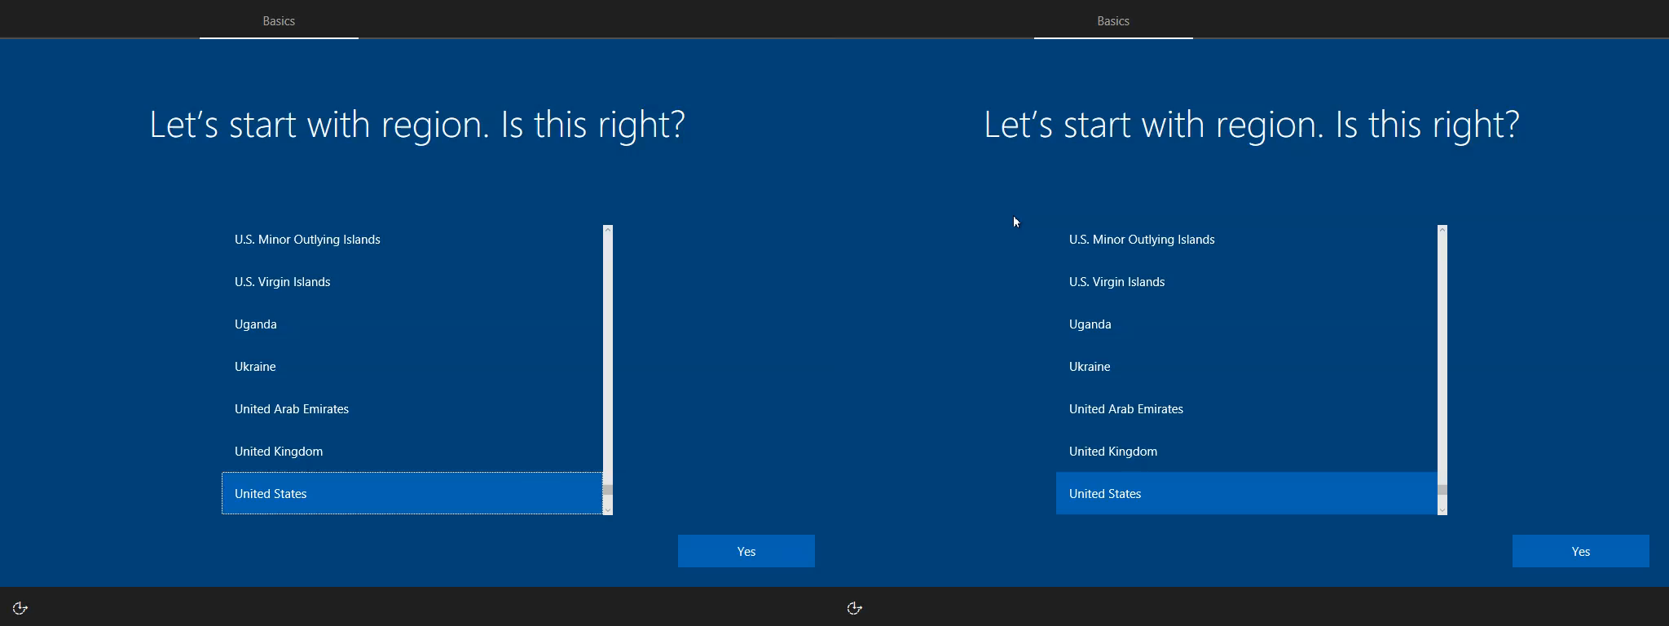
Seamless Deployment vs. Classic Setup
Windows 10 Autopilot, EMS and Office 365 ProPlus from box to productive user (& NOT a local admin)
Notes:
EDIT NOTE – For Tech Series, I think we can deprecate this video as they see it again in the “spidey” click through and experience in the lab.

Slide 5
Modern IT
Traditional IT
Cloud
Windows 10 designed for modern IT
Notes:
[Positioning]
Realistically, we all know that these initiatives and new solutions about moving customer to the cloud will not happen at one shot and overnight.
When we are talking about modern IT, it is important to recognize that it will come to a point that the customers need to be in a Hybrid mode.
There will be customers that will be running completely to the cloud or will still on-premise or customers that will slowly adopt the cloud and will be on hybrid state between on-prem and cloud.

Slide 6

I want
to pilot Windows 10 & Office 365 ProPlus in production
Scenarios
Deployment Scenarios
I want to
scale Windows 10 deployment
I want to retain my apps and settings when I move to Windows 10

Slide 7
Deployment Choices
Wipe & Load
In-Place Upgrade
Provisioning/AutoPilot
Familiar enterprise process for all scenarios
Capture Data / Settings
Deploy (custom) OS image
Inject Drivers
Install Apps
Restore Data / Settings
Still an option for all scenarios
Let Windows do the work
Preserve data, settings, apps, drivers
Install (standard) OS image
Restore everything
Recommended for existing Windows 7 / 8 / 8.1 devices
Recommended to upgrade Windows 10 devices to Creators update
New capability for new devices
Transform into an enterprise device
Remove bloatware and 3rd party branding
Add organizational apps
Add organizational configuration
For Windows 10 CYOD scenarios
Management feature
Notes:
Positioning
Microsoft believes the easiest approach is to leverage the in-place upgrade
Microsoft continue to support traditional deployment methods
Windows 10 hardware requirements unchanged from Windows 8.1
Provisioning [CLICK] is becoming a preferred way to rollout no-touch deployments for new devices in Modern IT Shops
Overview
For Windows 10, Microsoft will provide a few deployment choices. Firstly, Microsoft will still fully support the traditional wipe-and-load process, for customers that prefer to go that route.
For existing computers, however, the easiest approach is to leverage the in-place upgrade process to move from Windows 7, Windows 8, or Windows 8.1 directly to Windows 10. This process lets Windows do all the work for you – leveraging existing software distribution or patch deployment capabilities to initiate and monitor the upgrade process. This also works to update Windows 10 computers on the Current Branch to the November update of Windows 10 from the RTM version.
Microsoft will also provide new runtime provisioning capabilities to help transform a new device from its initial out-of-box configuration into a fully-configured enterprise device. Provisioning is a one time process designed to set configuration on the device rather than apply ongoing management. This transformation can change the SKU, install apps, apply configuration, and more. We believe this will enable organizations to effectively support choose your own device (CYOD) policies, giving end users more choice in the types of Windows devices they use.
Hardware Compatibility - From a compatibility perspective, we believe strongly that all devices running Windows 7, Windows 8, or Windows 8.1 will be able to run Windows 10. [NOTE: There are some specific hardware requirements, unchanged since Windows 8.1, that could result in a very small percentage of devices not being able to run Windows 10. These are generally consumer devices or very old enterprise devices, e.g. Pentium D processors running Windows 7 x64, and are extremely uncommon in modern enterprises.]

Slide 8
Transformation Choices
Windows 10
Wipe & Load or Device Refresh
In-Place Upgrade
Feature Adoption
Windows 10
Device Guard
Windows Hello
WIP
Windows 7
Credential Guard
Credential Guard
UI
UWP
UI
UWP
Edge
Cortana
Edge
Cortana
Store
Performance
Store
Performance
Time
Notes:
Positioning
Generally speaking, devices are more secure on Windows 10 with limited capabilities implemented than they are on Windows 7
Instead of waiting for all capabilities or features of Windows 10 to be ready ahead of deployment, consider using in-place upgrade for existing devices and enable credential guard for those devices in the environment that can support it.
<Beginning> Windows 7 / Current OS
<CLICK-1> Windows 10 + Full Feature Stack
<CLICK-2> Advantages of in-place upgrade
<CLICK-3> Minimize gap – address features/changes to device effort either via Wipe & Load or Device Refresh

Slide 9
Out of Box Provisioning

Slide 10
Azure AD Join for Windows 10
Benefits
Azure Active Directory
Microsoft Intune
Apps in Azure
3rd party apps & clouds
Azure AD Join makes it possible to connect work-owned Windows 10 devices to your company’s Azure Active Directory without need for MSA.
Self-service setup & sign in with Azure AD account
Ideal for users who primarily access Office365 & Cloud apps
Automatic enrollment to Intune MDM
Single sign-on from the desktop to cloud and on-premises applications with no VPN
Support for hybrid environments
Intune/MDM
auto enrollment
On-premises apps
Windows 10 Azure AD Joined Devices

Slide 11
Windows for Work
 | Domain Join | Azure AD Join | Add a Work Account
Ownership | Organization | Organization | Personal
Provisioning | Prepared by IT | Self configure in OOBE | Self configure in Settings>>Accounts
Management | Existing management solutions (e.g. SCCM, GP, etc.) | MDM | MDM
Resources | SSO to enterprise resources hosted primarily on-premises and in the cloud | SSO to enterprise resources in the cloud, and to on-premises resources exposed via Proxy | SSO to enterprise resources in the cloud.
Deployment | Traditional work place | Seasonal workers, CYOD | BYOD
Devices | Windows PCs and Tablets | Windows PCs, Tablets, and Windows Phone | Windows PCs, Tablets, and Windows Phone
Notes:
[Positioning]

Slide 12
Azure AD Bulk Enrollment
IT uses WCD tool to create a provisioning package supporting AADJ and MDM enrollment
IT applies provisioning package during first boot of Windows thru USB
Windows 10 device is delivered to the employee
Employee signs into the Windows 10 device with his corporate credentials and the device is ready to use
Notes:
[Positioning]
Azure AD bulk provisioning
Generate a token (good for a period of time) to join machines
Deploy the token to PCs using provisioning packages (for now)
Integrating provisioning packages into existing processes
PowerShell cmdlets for installing provisioning packages

Slide 13

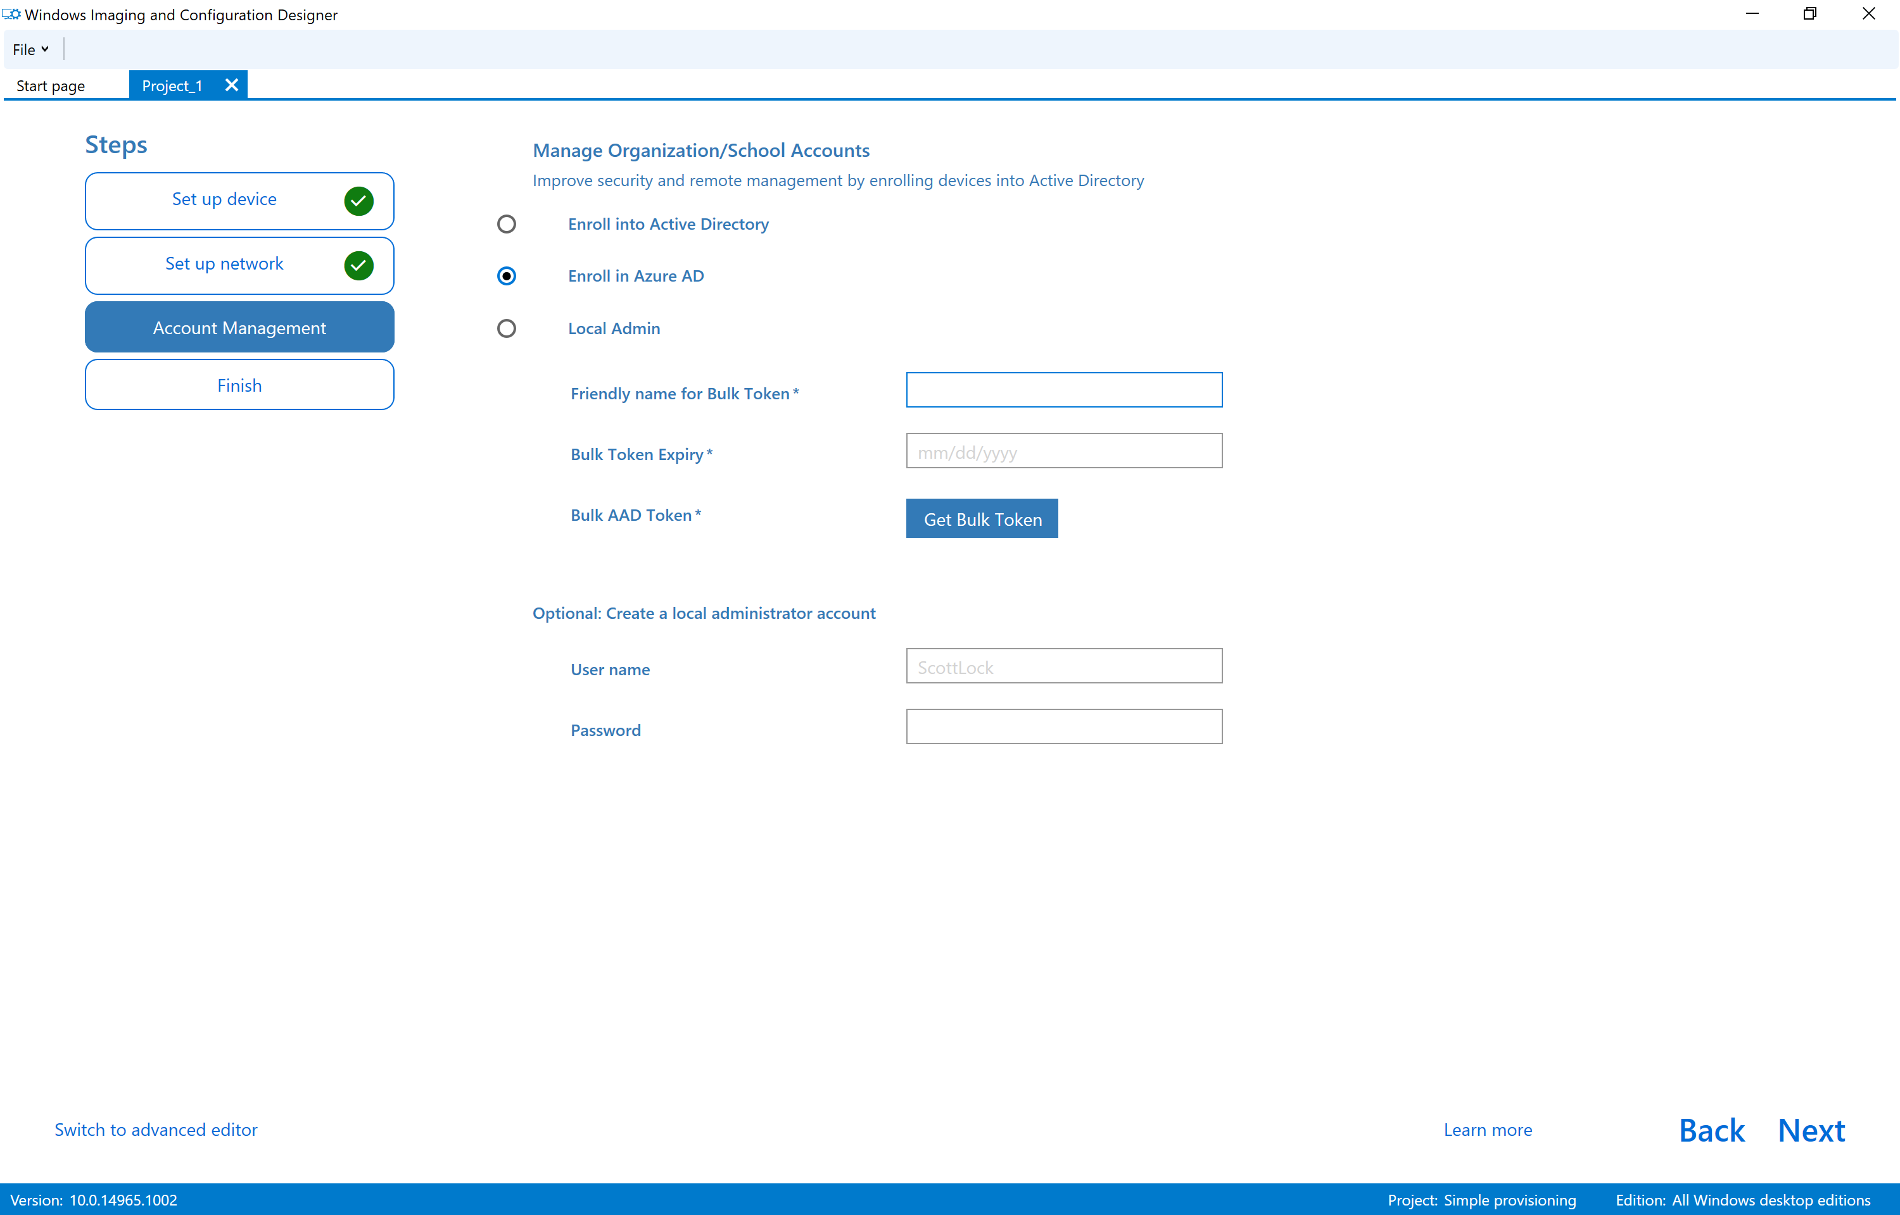
Windows Modern Deployment: WCD
Create Provisioning Package
Deploy Provisioning Package
New features for RS2:
Automated Azure AD join
Enhanced app installation support
PowerShell cmdlets for installing and removing provisioning packages
WCD as a Store application
OEM pre-install removal
Windows Configuration Designer installation via the Windows Store
Notes:
Working on capabilities to easily remove preinstalled software
Reset-like process to remove apps
Preserves critical customizations (e.g. power plans)
Can take 20-30 minutes, depending on hardware
Can be automated

Slide 14
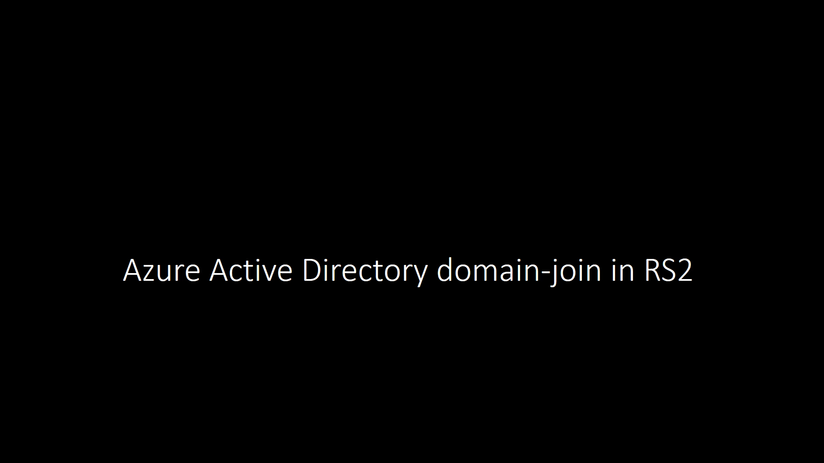
Bulk Enrollment Video

Slide 15
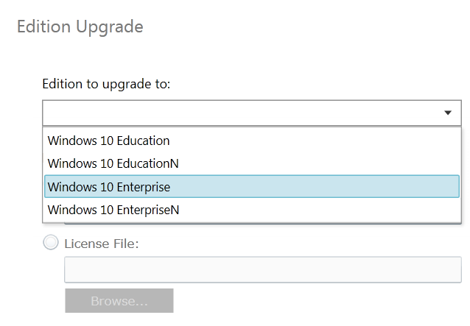
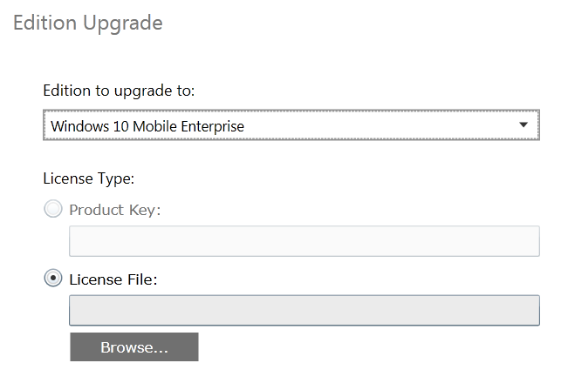
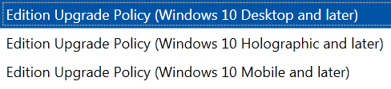
Windows 10 Edition Upgrade
Edition Upgrade
Seamless upgrade from PRO -> ENT, PRO -> EDU
Support for Desktop, Mobile and Holographic SKUs
Architecture built to secure the keys in our service
1709 Update - Windows 10 Subscription Activation lets you deploy Windows 10 Enterprise in your organization with no keys and no reboots using a list of subscribed users. When a subscribed user signs in on their Windows 10 Pro device, features that are Enterprise-only are automatically enabled.
Notes:
[Positioning]
Moving from Pro to Enterprise has gotten consistently easier
Windows 7: Wipe and load
Windows 8.1: In-Place Upgrade
Windows 10 1507: Provisioning package, MDM policy, plus a reboot
Windows 10 1607: Change product key, no reboot
Now very easy to do, in various ways:
Use SLMGR.vbs to change key
Use a provisioning package
Using an MDM policy
AAD-assigned subscription license

Slide 16
Windows Autopilot

Slide 17

Why Windows Autopilot
Out of the box and ready to go
Unbox your new Windows device and turn it on. Windows Autopilot configures it from the cloud— with a few simple clicks, the device becomes business-ready.
Move to the cloud at your own pace
Windows Autopilot can join devices to Azure Active Directory and enroll them in mobile device management.
Keep track of the whole process
With Windows Autopilot, users can see how configuration is progressing.
Provisioning minus the hassle
Deliver a better user experience with personalization and fewer steps to set up.

Slide 18
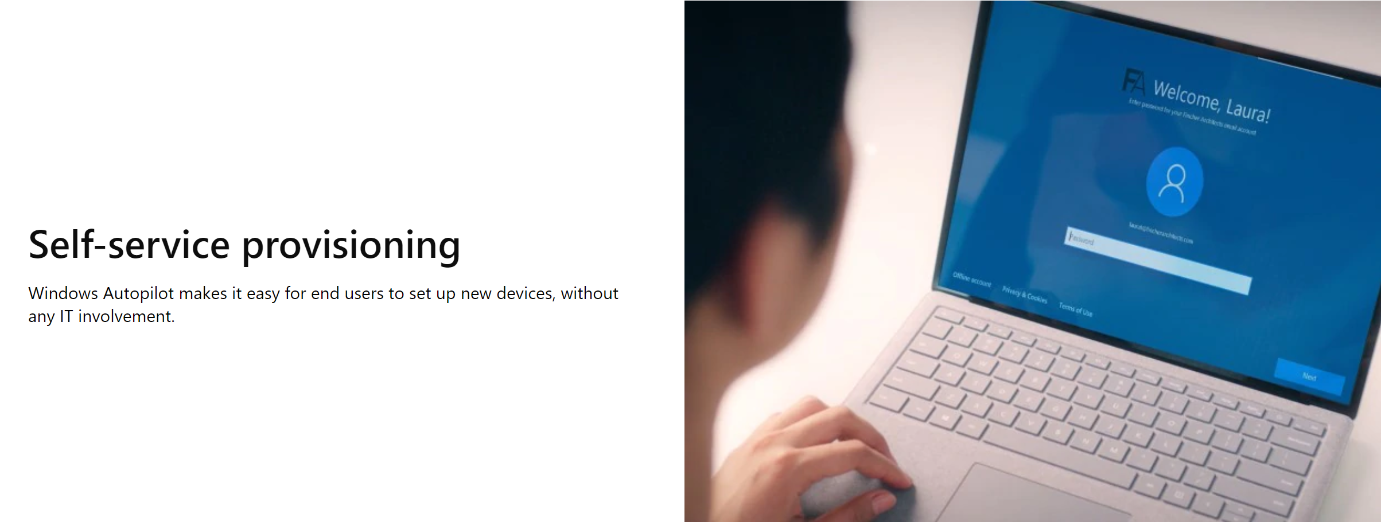
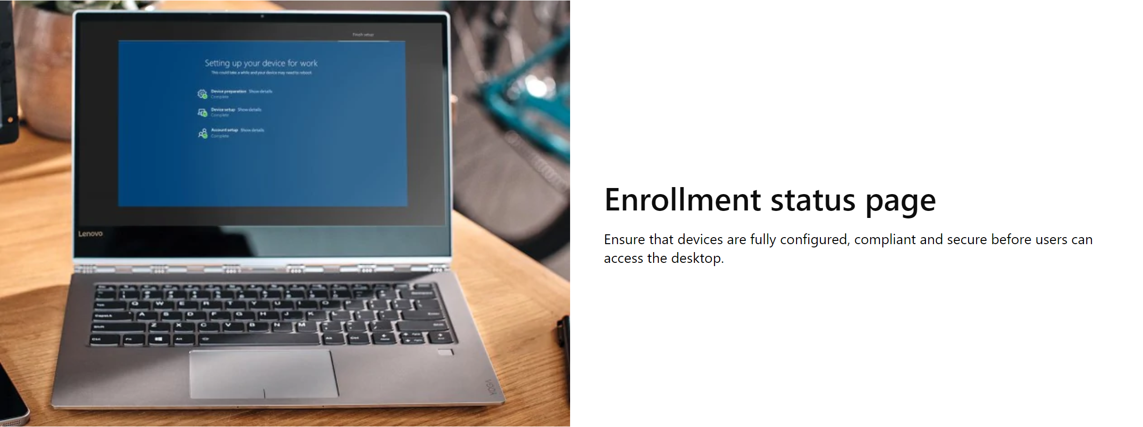

Windows Autopilot Features
Windows Autopilot provides set up and pre-configuration services for new devices, so they're ready for productive use right out of the box.
Windows Autopilot self-deploying device
Enjoy zero-touch provisioning - just plug the device into ethernet, power it on, and watch Windows Autopilot do its magic.

Slide 19
How it works?
With Windows Autopilot, there’s no need to reimage or manually set up new devices before handing them out to your users. Your hardware vendor can ship them, ready to go, straight to your employees.
1. Device registration
The hardware vendor automatically adds new devices to the Autopilot deployment service, claiming ownership for your organization.
2. Profile creation & assignment
Customize the user set up experience and configuration by creating a deployment profile that you can assign to your organization’s devices.
3. Shipping
Your hardware vendor ships the device to your employee. When they turn it on and go online, Windows Autopilot delivers all the apps and settings they need.
Notes:
Device ID's - start talking to manufacturers now.
<FUTURE – DO NOT PRESENT> Most people don't know these exist yet - how do you get it on the order? Who sends it? What formats? What tools support harvesting from existing device

Slide 20
How it works?
Windows AutoPilot Deployment Service
Upload
Device IDs*
Configure Profile
Existing Devices
Self
Deploy
Device IDs
Harvest Device IDs
Hardware Vendor
IT Admin
Ship
Deliver direct to Employee
Employee unboxes device, self-deploys
*1803 Update - Hardware vendor can deploy configuration profiles. Deployment Profiles can also be applied via the Microsoft Store for Business.
https://docs.microsoft.com/en-us/windows/deployment/windows-autopilot/windows-10-autopilot
Notes:
Device ID's - start talking to manufacturers now.
<FUTURE – DO NOT PRESENT> Most people don't know these exist yet - how do you get it on the order? Who sends it? What formats? What tools support harvesting from existing device

Slide 21

Notes:
Create your own narrative here! ☺

Slide 22
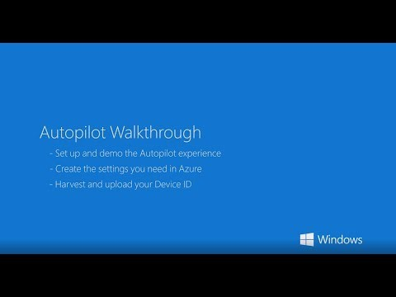
Setting up Windows Autopilot

Slide 23
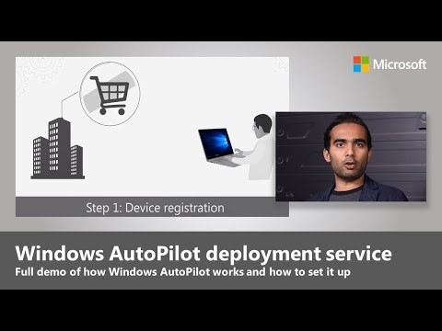
Using Windows Autopilot

Slide 24
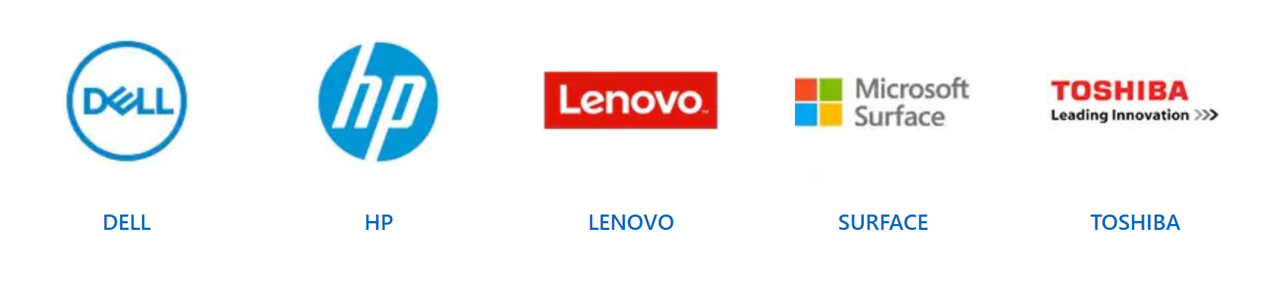
Participant device manufacturers
These brands ship devices using Windows Autopilot. When you purchase from them, your employees will receive devices ready to go, just by signing in — requiring no help from IT.

Slide 25
Labs
2 – Dynamic Deployment: Use provisioning packages for Windows deployments
3 – Windows AutoPilot Deployment
https://m365.learnondemand.net
Notes:
Refer to section 5.5 of the Lab Guide for the step by step guidance.

Slide 26
Thank You

